Slide 1
TALIA TECHNOLOGY SOLUTIONS
Nurturing Your Innovations

Slide 2

About us
Mission
Business Consulting while helping customers we help innovators to nature their innovations and assist industry leaders in adopting new technologies.
Vision
To be the valued and preferred provider of Technology 4.0 while enabling industry leaders to revolutionize the next disruption.
We are a team who are prepared to pivot and adapt to all types of disruptions in the way.
As strategic technology trends do not operate independently, they build on and reinforce each other.
We look forward to enabling organizational plasticity that will help guide organizations in the coming years.

Slide 3

We handle a wide variety of application development services including:
Custom software development
Product Engineering
Mobile Application Development
SaaS Development
Digital Transformation
Application Outsourcing
Content Creating
Portal Development

Slide 4

We are prepared to pivot and adapt to all types of disruptions in the way. As strategic technology trends do not operate independently, they build on and reinforce each other.
Emerging Technologies
As the World is racing towards vaccinating humans for COVID-19. We are focusing on, IoT, AI, Serverless Computing, Blockchain, Cloud, Robotics, Biometrics, 3D Printing and Virtual Reality/Augmented Reality that could help industry with these technologies help us get a leading advantage for next disruption.
India is now getting ready for emerging technologies these are going to play a crucial role in any industry alike, whether it is planning or decision-making; accelerating development or analyzing deployment, problem solving or product development; discovering new trends or drawing out correlations.

Slide 5

Our team of highly efficient resources employs an agile development process to ideate, research, design, and build applications using the best-in-class tools and technologies. With a premium to build apps of the highest quality and within the stipulated timeline, we help you go from idea to market in the shortest time.
Application Services:
Application Development
Mobility Solutions
Digital & Transformational Solutions:
Cloud Services
Digital Workplace
Digital Marketing
Technology Solutions:
Product Engineering
Digital Asset Management
Content Management
Software Services:
Custom Development
Software Outsourcing
Staffing Services
Agile Development
UI & UX:
Experience Design
User Interface Design
Web Development

Slide 6

CASE STUDIES
ITES & LEADING BANKING INDUSTRY
Problem Statement - Unified dashboard for a leading banking firm and enhanced UI & UX for vertical and geo leaders for an ITES.
Solution - Dashboards must always save the user time. Always design your dashboard so that it helps your user to be more efficient.
Operational dashboards – these dashboards help the user see what's happening right now
Analytical dashboards – these dashboards give the user a clear view of performance trends and potential problems.
Strategic dashboards – this type of dashboard lets the user track their main strategic goals via KPIs

Slide 7
CASE STUDIES
LEADING BANKING INDUSTRY
Problem Statement - Usually, banks email the monthly bank statement directly to their customer’s registered email address every month which are not interactive.
Solution – Smart Statements Design includes all the transactions either withdrawal or deposit of money, account balance, interest credited, and amount debited for any services.
Increase their visibility on spending
Cross selling and Up selling banking and 3rd party products
Retaining customer trust and increased relationship

Slide 8
CASE STUDIES
LEADING FMCG INDUSTRY
Problem Statement – FMCG and CPG woes in the growth of current data streams including sales, finance, promotional, supply chain and social media etc. So, to overcome these issues.
Solution – Optimizing warehouse management, inventory levels enhancement, and compelling value via whole supply chain.
Optimizing warehouse management, inventory levels enhancement, and compelling value via whole supply chain
Generating high profitability and revenue over all channels across the customer decision drive.

Slide 9


Why Talia Technologies ?
We work with Business Leaders and Innovators together to design, create and produce work that we are proud of for the Vision and Mission we believe in.
We are available to be hired for:
Low-cost structure
Professional competence
Industriousness
High learning ability
Adaptability to technology
High acceptability
Strong interpersonal skills

Slide 10
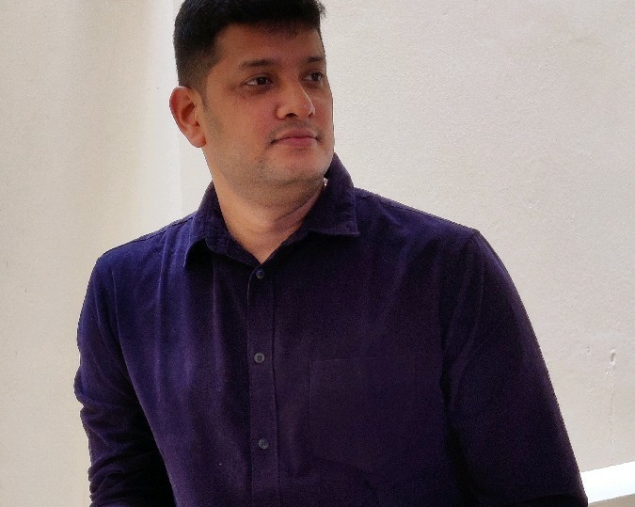



SOLUTIONS TEAM
Narayanamurthy T
Rakesh Nair
As a Data strategist, analyze data for trends and patterns and interpret data with a clear objective in mind and execute the development of data products. Worked with Customers viz Microsoft/ Amazon/ Uber in IT/ITES Technology. Currently analytics leader in Retail and Logistics verticals.
One of our advisory panel, Specialties in areas of automation, capacity planning, coaching, computer hardware, mentoring, customer relations, customer excellence, inventory management, MIS, Data Analytics, organizational skills, high performance management, P&L management, process management, supervisory skills, technical support.
Vinod Kumar Jhadav
Ajit Kumar Mishra
He is acknowledged for providing leadership, strategic transformation, and operational discipline for a wide array of business processes within organizations. An agile coach being a effective communicator with excellent relationship building & interpersonal skills; self-motivator with high levels of commitment.
A Solution Architect and Cloud evangelist having worked for Finance, Retail , Pharma and Oil & Gas customers primarily involved with estimations, Resource Modelling, Costing and Pricing of multi-year, multi million opportunities. Additionally involved with orals and client visits, project planning.

Slide 11
Digital Transformation Governance:
Centralize Shared Information – Centralize information about Digital Initiatives rather than the initiative themselves.
Decentralize Governance of Digital Initiatives over Time – As digital maturity grows, move from Centralized to Decentralized governance of initiatives.
Decentralize Ideation. Centralize Idea Evaluation – Decentralize Ideation but Centralize Idea evaluation and prioritization.
Ensure KPIs Measure True Impact – Ensure that KPIs measure the real impact you want to achieve with each initiative.
Focus on Compatibility, Consistency, and Continuous Integration – Avoid Siloed solutions by ensuring data compatibility, technical consistency, and continuous integration of new initiatives with existing systems.
Implement a "Fit-for-Purpose" Mapping System – Implement a "Fit-for-Purpose" mapping system that recognizes value potential and degree of feasibility for each initiative.
Perform Scenario Analysis – Evaluate different scenarios to steward Digital Initiatives toward full-scale impact proactively.

Slide 12

RX Shortages - Retailer app and web application provides an innovative solution for pharma retailers/Chemist’s cumbersome manual order process or phone order process.
The app is known for being a reliable, time-saving tool that keeps you focused on making the best clinical and pharma decisions possible.
Place order for all the shortage items at once to your preferred distributors
A drug-interaction checker
Identify pills
Look up prescription medications
Determine drug dosing
Check drug interactions
Use medical calculators
Enjoy the benefits of knowing offers, comparative rates upfront before placing the order
Order any time.... even before closing the store and get the stock delivered early in the morning
Know the distributors stack availability before placing the order
Get Notification updates
Track previous orders history
Notifications that consider the topics you’ve previously read and related information
Save Time
Save Resources Save Money
Benefits
Efficiency
Accuracy
Convenience

Slide 13

We take the hassle out of device lifecycle and maintenance management. IT infrastructure is often stretched thinly across essential initiatives like Digital Transformation, helping your employees adapt to remote working, and security.
Device As A Service (DaaS)
With our Device As A Service (DaaS) we are tied up leading device providers, so that you get the right devices, repair services, and AI-driven analytics in a predictable payment with flexible terms to optimize your cash flow.
We assist you to increase user productivity, operational efficiency, and business flexibility.
Make the most of your investments
Free up cash flow
Improve the employee experience
Get right devices for the job
Support for maximum uptime
Increase in your ROI

